Slide 1

Predicting Heart Disease
An Exploratory Data Analysis
Karthik Badiganti
kbadigan@kent.edu

Slide 2

Introduction
Objective: To predict heart diseases using the Cleveland heart disease dataset.
Dataset Source: UCI Machine Learning Repository, Kaggle Public Data Sets.
Importance: Early detection of heart diseases for effective medical intervention.

Slide 3
Dataset Overview
Dataset Source: Cleveland Heart Disease dataset.
Features: Subset of 14 features from 76 attributes.
Instances: Total number of samples is 304.

Slide 4
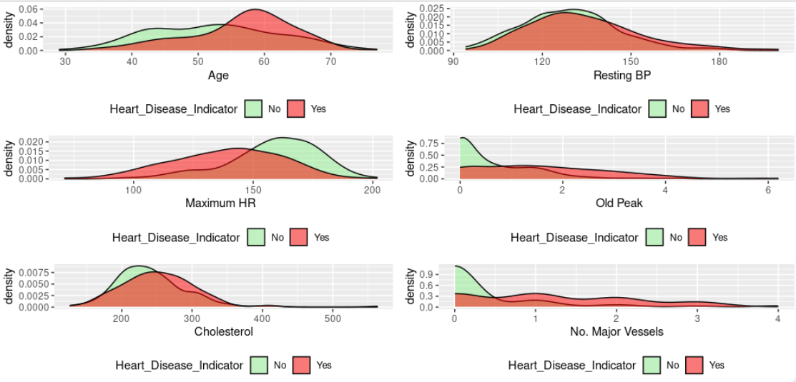
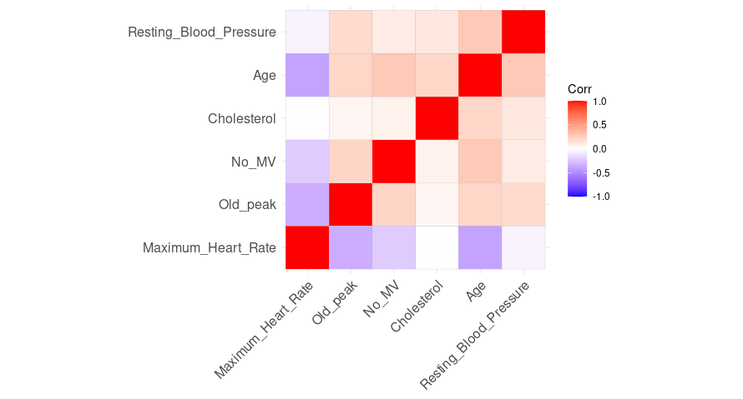
Data Exploration
A Density Plot of the available columns with the predictor variable.

Slide 5
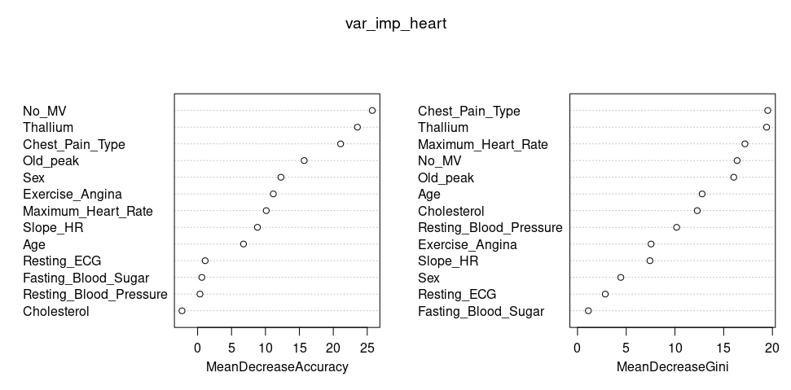
Variable Importance
Age & Disease: Age's limited impact on predicting heart disease.
Gender & Disease: Gender differences in disease prevalence.
Chest Pain: Distribution of chest pain types among patients.
Cholesterol: Cholesterol levels and their role in heart disease.

Slide 6
Model Building
Selection of Models:
Logistic Regression
Random Forest
K-Nearest Neighbors (KNN)
Decision Trees
Ada Boost

Slide 7
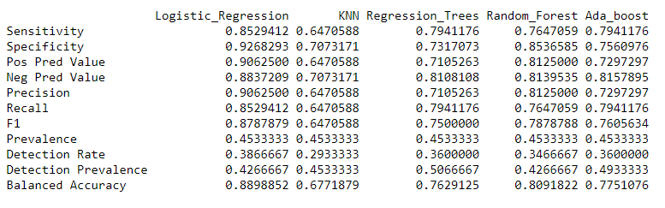
Results

Slide 8
Insights
Age isn't the sole predictor: Age alone doesn't distinctly predict heart disease, with occurrences spread across age groups.
Gender disparity: Heart disease is more prevalent in males compared to females.
Cholesterol matters: High cholesterol levels, especially in males, correlate with heart disease.
Model accuracy: Logistic Regression and Random Forest models exhibit superior accuracy, with sensitivity and specificity as key metrics for evaluation.

Slide 9
Conclusion
Successful disease prediction demonstrated using machine learning models on the Cleveland heart disease dataset.
Identification of key predictive features through exploratory data analysis, distinguishing impactful variables from less influential ones.
Top performance observed with Logistic Regression and Random Forest models, showcasing remarkable accuracy in disease prediction.
Future potential lies in enhancing sensitivity and specificity through increased data volume and advanced feature selection techniques.

Slide 10
References
https://www.heartandstroke.ca/heart-disease/what-is-heart-disease/types-of-heart-disease
https://archive.ics.uci.edu/ml/datasets/heart+disease
https://uc-r.github.io/regression_trees
https://towardsdatascience.com/random-forest-in-r-f66adf80ec9
http://finzi.psych.upenn.edu/R/library/caret/html/sensitivity.html

